Slide 1


Alpha Anywhere Q&A
February 23, 2022

Slide 2


Slide 3
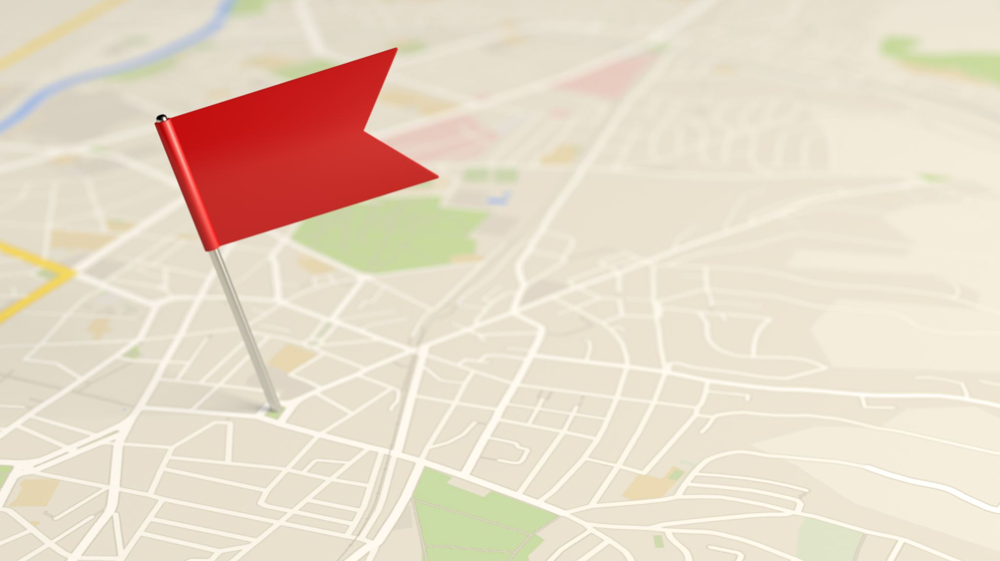
Register at www.alphasoftware.com/devcon2022

Slide 4

Geography Search Part 2
Querying geospatial data to gain insights and drive better decisions

Slide 5

Geospatial Data
Information that describes objects, events, or other features with a location on or near the Earth's surface.
Geospatial Data includes locations, line segments, and polygon data

Slide 6
Storing Geospatial Data
Data stored as a Geometry or Geography data type
Database Support: SQL Server, Oracle, DB2, PostgreSQL, MySQL
Support varies significantly between different database systems

Slide 7

Geography Search - Lists
Built-in support for encoding locations as Geography Data
Need to build your own Search UI
Portable SQL Geography Functions
Demo: Radius Search

Slide 8

Portable SQL Geography Functions
GeogLocationIsWithinRadius()
Matches all records with a Location within X meters of a Location
GeogLocationIsWithinPolygon()
Matches all records with a Location within a Polygon defined as 3 or more Locations
GeogCreateLocation()
Creates a Location from a Longitude and Latitude value
GeogCreatePolygon()
Creates a Polygon from a list of Longitude and Latitude values

